Slide 1
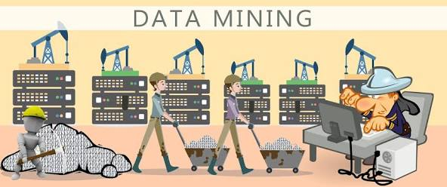
DATA MINING CONCEPTS
ASSOCIATION RULES
Present by: Arelia Nalle Kharjana
Date: 9th of June, 2017

Slide 2
CONTENTS:
Association
Association Rules
Market-Basket Model, Support, and Confidence
Apriori Algorithm
Sampling Algorithm
Other Algorithms for Association rules
Frequent-Pattern (FP) Tree and FP-Growth Algorithm
Partition Algorithm
Other Types of Association Rules
Association Rules among Hierarchies.
Multidimensional Associations.
Negative Associations.
Additional Considerations for Association Rules
References

Slide 3
Association
Retail shops are often interested in associations between different items that people buy. Examples of such associations are:
Someone who buys bread is quite likely also to buy milk
A person who bought the book Database System Concepts is quite likely also to buy the book Operating System Concepts.
Association information can be used in several ways. When a customer buys a particular book, an online shop may suggest associated books.
A grocery shop may decide to place bread close to milk, since they are often bought together, to help shoppers finish their task faster. Or the shop may place them at opposite ends of a row, and place other associated items in between to tempt people to buy those items as well, as the shoppers walk from one end of the row to the other.
A shop that offers discounts on one associated item may not offer a discount on the other, since the customer will probably buy the other anyway.

Slide 4
Association Rules
An association rule is of the form X=> Y, where X={x₁,x₂,…,x_{n}} and Y= {y₁,y₂,…,y_{m}} are sets of items, with x_{i} and y_{i} being distinct items for all i and all j.
This association states that if a customer buys X, he or she is likely to buy Y.
In general, any association rule has the form LHS (left-hand side) => RHS (right-hand side), where LHS and RHS are sets of items.
The set LHS ∪ RHS is called an itemset, the set of items purchased by customers.

Slide 5
Association Rules
An example of an association rule is:
bread ⇒ milk
In the context of grocery-store purchases, the rule says that customers who buy bread also tend to buy milk with a high probability.
An association rule must have an associated population: the population consists of a set of instances.
In the grocery-store example, the population may consist of all grocery store purchases; each purchase is an instance.
In the case of a bookstore, the population may consist of all people who made purchases, regardless of when they made a purchase. Each customer is an instance.

Slide 6
Market-Basket Model, Support and Confidence
The database is regarded as a collection of transactions, each involving a set of items.
A common example is that of market-basket data. Here the market basket corresponds to the sets of items a consumer buys in a supermarket during one visit.
Rules have an associated support, as well as an associated confidence. These are defined in the context of the population:
The support for a rule LHS => RHS is with respect to the itemset; it refers to how frequently a specific itemset occurs in the database.
That is, the support is the percentage of transactions that contain all of the items in the itemset LHS ∪ RHS.
If the support is low, it implies that there is no overwhelming evidence that items in LHS ∪ RHS occur together because the itemset occurs in only a small fraction of transactions.

Slide 7
Market-Basket Model, Support and Confidence
Another term for support is prevalence of the rule.
For instance, suppose only 0.001 percent of all purchases include milk and screwdrivers. The support for the rule is low.
milk ⇒ screwdrivers
The rule may not even be statistically significant—perhaps there was only a single purchase that included both milk and screwdrivers.
Businesses are usually not interested in rules that have low support, since they involve few customers, and are not worth bothering about.
The confidence is with regard to the implication shown in the rule.
The confidence of the rule LHS => RHS is computed as the support(LHS ∪ RHS)/support(LHS).

Slide 8
Market-Basket Model, Support and Confidence
We can think of it as the probability that the items in RHS will be purchased given that the items in LHS are purchased by a customer.
Another term for confidence is strength of the rule.
For instance, the rule
bread ⇒ milk
has a confidence of 80 percent if 80 percent of the purchases that include bread also include milk.
A rule with a low confidence is not meaningful.

Slide 9
Apriori Algorithm
Apriori Algorithm for Finding Frequent (Large) Itemsets
Input: Database of m transactions, D, and a minimum support, mins, represented as a fraction of m.
Output: Frequent itemsets, L₁, L₂, ..., L_{k}
Begin /* steps or statements are numbered for better readability */
Compute support(i_{j}) = count(i_{j})/m for each individual item, i₁, i₂, ..., i_{n} by scanning the database once and counting the number of transactions that item i_{j} appears in (that is, count(i_{j}));
The candidate frequent 1-itemset, C₁, will be the set of items i₁, i₂, ..., i_{n};
The subset of items containing i_{j} from C₁ where support(i_{j}) >= mins becomes the frequent 1-itemset, L₁;
k = 1;
termination = false;
repeat

Slide 10
Apriori Algorithm
L_{k+1} = ;
Create the candidate frequent (k+1)-itemset, C_{k+1}, by combining members of L_{k} that have k–1 items in common (this forms candidate frequent (k+1)-itemsets by selectively extending frequent k-itemsets by one item);
In addition, only consider as elements of C_{k+1} those k+1 items such that every subset of size k appears in L_{k};
Scan the database once and compute the support for each member of C_{k+1}; if the support for a member of C_{k+1} >= mins then add that member to L_{k+1};
If L_{k+1} is empty then termination = true
else k = k + 1;
until termination;
End;

Slide 11
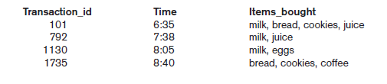
Apriori Algorithm
We illustrate the Algorithm using the transaction data in Figure 1 using a minimum support of 0.5.
The candidate 1-itemsets are {milk, bread, juice, cookies, eggs, coffee} and their respective supports are 0.75, 0.5, 0.5, 0.5, 0.25, and 0.25.
The first four items qualify for L1 since each support is greater than or equal to 0.5.
Figure 1: Sample transactions in
market-basket model.

Slide 12
Apriori Algorithm
In the first iteration of the repeat-loop, we extend the frequent 1-itemsets to create the candidate frequent 2-itemsets, C2.
C2 contains {milk, bread}, {milk, juice}, {bread, juice}, {milk, cookies}, {bread, cookies}, and {juice, cookies}. Notice, for example, that {milk, eggs} does not appear in C2 since {eggs} is small (by the antimonotonicity property which states that once an itemset is found to be small then any extension to that itemset, formed by adding one or more items to the set, will also yield a small itemset.) and does not appear in L1.
The supports for the six sets contained in C2 are 0.25, 0.5, 0.25, 0.25, 0.5, and 0.25 and are computed by scanning the set of transactions.
Only the second 2-itemset {milk, juice} and the fifth 2-itemset {bread, cookies} have support greater than or equal to 0.5.
These two 2-itemsets form the frequent 2-itemsets, L2.

Slide 13
Apriori Algorithm
In the next iteration of the repeat-loop, we construct candidate frequent 3-itemsets by adding additional items to sets in L2.
However, for no extension of itemsets in L2 will all 2-item subsets be contained in L2.
For example, consider {milk, juice, bread}; the 2-itemset {milk, bread} is not in L2, hence {milk, juice, bread} cannot be a frequent 3-itemset by the downward closure property (which states that, a subset of a large itemset must also be large, that is, each subset of a large itemset exceeds the minimum required support).).
At this point the algorithm terminates with L1 equal to {{milk}, {bread}, {juice}, {cookies}} and L2 equal to {{milk, juice}, {bread, cookies}}.

Slide 14
Sampling Algorithm
The main idea for the Sampling algorithm is to select a small sample, one that fits in main memory, of the database of transactions and to determine the frequent itemsets from that sample.
If those frequent itemsets form a superset of the frequent itemsets for the entire database, then we can determine the real frequent itemsets by scanning the remainder of the database in order to compute the exact support values for the superset itemsets.
A superset of the frequent itemsets can usually be found from the sample by using, for example, the Apriori algorithm, with a lowered minimum support.
In some rare cases, some frequent itemsets may be missed and a second scan of the database is needed. To decide whether any frequent itemsets have been missed, the concept of the negative border is used.

Slide 15
Sampling Algorithm
The negative border with respect to a frequent itemset, S, and set of items, I, is the minimal itemsets contained in PowerSet(I) and not in S.
The basic idea is that the negative border of a set of frequent itemsets contains the closest itemsets that could also be frequent.
Consider the case where a set X is not contained in the frequent itemsets. If all subsets of X are contained in the set of frequent itemsets, then X would be in the negative border.
We illustrate this with the following example. Consider the set of items I = {A, B, C, D, E} and let the combined frequent itemsets of size 1 to 3 be S = {{A}, {B}, {C}, {D}, {AB}, {AC}, {BC}, {AD}, {CD}, {ABC}}. The negative border is {{E}, {BD}, {ACD}}.

Slide 16
Sampling Algorithm
The set {E} is the only 1-itemset not contained in S, {BD} is the only 2-itemset not in S but whose 1-itemset subsets are, and {ACD} is the only 3-itemset whose 2-itemset subsets are all in S.
The negative border is important since it is necessary to determine the support for those itemsets in the negative border to ensure that no large itemsets are missed from analyzing the sample data.
Support for the negative border is determined when the remainder of the database is scanned. If we find that an itemset, X, in the negative border belongs in the set of all frequent itemsets, then there is a potential for a superset of X to also be frequent.
If this happens, then a second pass over the database is needed to make sure that all frequent itemsets are found.

Slide 17
Other Algorithms
Frequent-Pattern (FP) Tree and FP-Growth Algorithm
Partition Algorithm

Slide 18
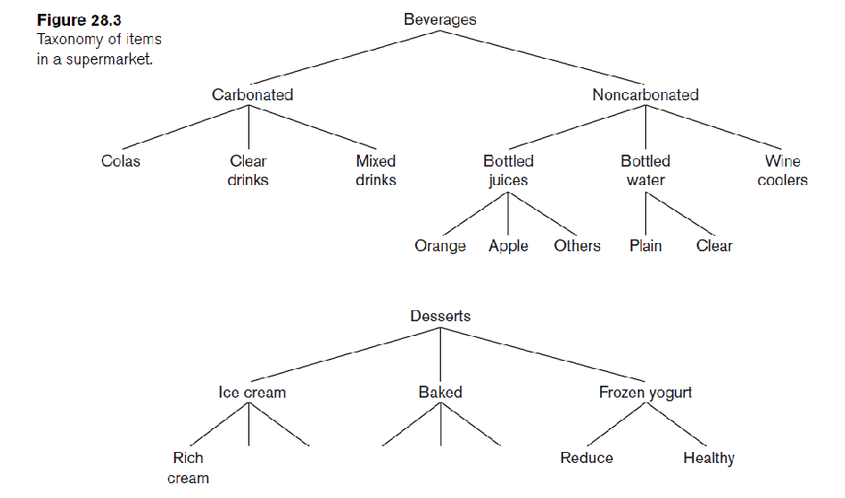
Other Types of Association Rules
Association Rules among Hierarchies.
There are certain types of associations that are particularly interesting for a special reason. These associations occur among hierarchies of items.
Typically, it is possible to divide items among disjoint hierarchies based on the nature of the domain.
For example, foods in a supermarket, items in a department store, or articles in a sports shop can be categorized into classes and subclasses that give rise to hierarchies.

Slide 19
Other Types of Association Rules
Multidimensional Associations.
Discovering association rules involves searching for patterns in a file.
It may be of interest to find association rules that involve multiple dimensions, for example, Time(6:30...8:00) => Items_bought(milk). Rules like these are called multidimensional association rules.
Negative Associations.
The problem of discovering a negative association is harder than that of discovering a positive association.
A negative association is of the following type: 60 percent of customers who buy potato chips do not buy bottled water.
Here, the 60 percent refers to the confidence for the negative association rule.

Slide 20
Additional Considerations for Association Rules
Mining association rules in real-life databases is complicated by the following factors:
The cardinality of itemsets in most situations is extremely large, and the volume of transactions is very high as well. Some operational databases in retailing and communication industries collect tens of millions of transactions per day.
Transactions show variability in such factors as geographic location and seasons, making sampling difficult.
Item classifications exist along multiple dimensions. Hence, driving the discovery process with domain knowledge, particularly for negative rules, is extremely difficult.
Quality of data is variable; significant problems exist with missing, erroneous, conflicting, as well as redundant data in many industries.

Slide 21
References:
Database System Concepts, Fourth Edition
A. Silberschatz,
H.F Korth,
S. Sudarshan
Fundamentals of Database Systems, Sixth edition
Ramez Elmasri,
Shamkant B. Navathe

Slide 22
THANK YOU

